Slide 1
Pregnancy Prevention
Starting contraception
Quickly and safely
This presentation does not take the place of your independent clinical judgement/ due diligence

Slide 2
“The American Academy of Pediatrics recommends that pediatricians develop a working knowledge of contraception to help adolescents reduce risks of and negative health consequences related to unintended pregnancy”
Pediatrics (2014) 134 (4): e1244–e1256.

Slide 3
Important (beyond today)
LGBTQIA+ support
Consent, coercion, safety
Cultural identity, sexuality, gender identity, fertility life-choices
Extended cycling
Non-contraceptive benefits
Abortion landscape

Slide 4
Resources
CDC Medical Eligibility Criteria
Reproductive Health National Training Center
Bedsider.Org
x4443
Notes:
https://rhntc.org/

Slide 5
Starting Birth Control Quickly & Safely
Risk of Pregnancy
Estrogen Contraindications
Pick a Method, Counsel & Start
Follow Up

Slide 6
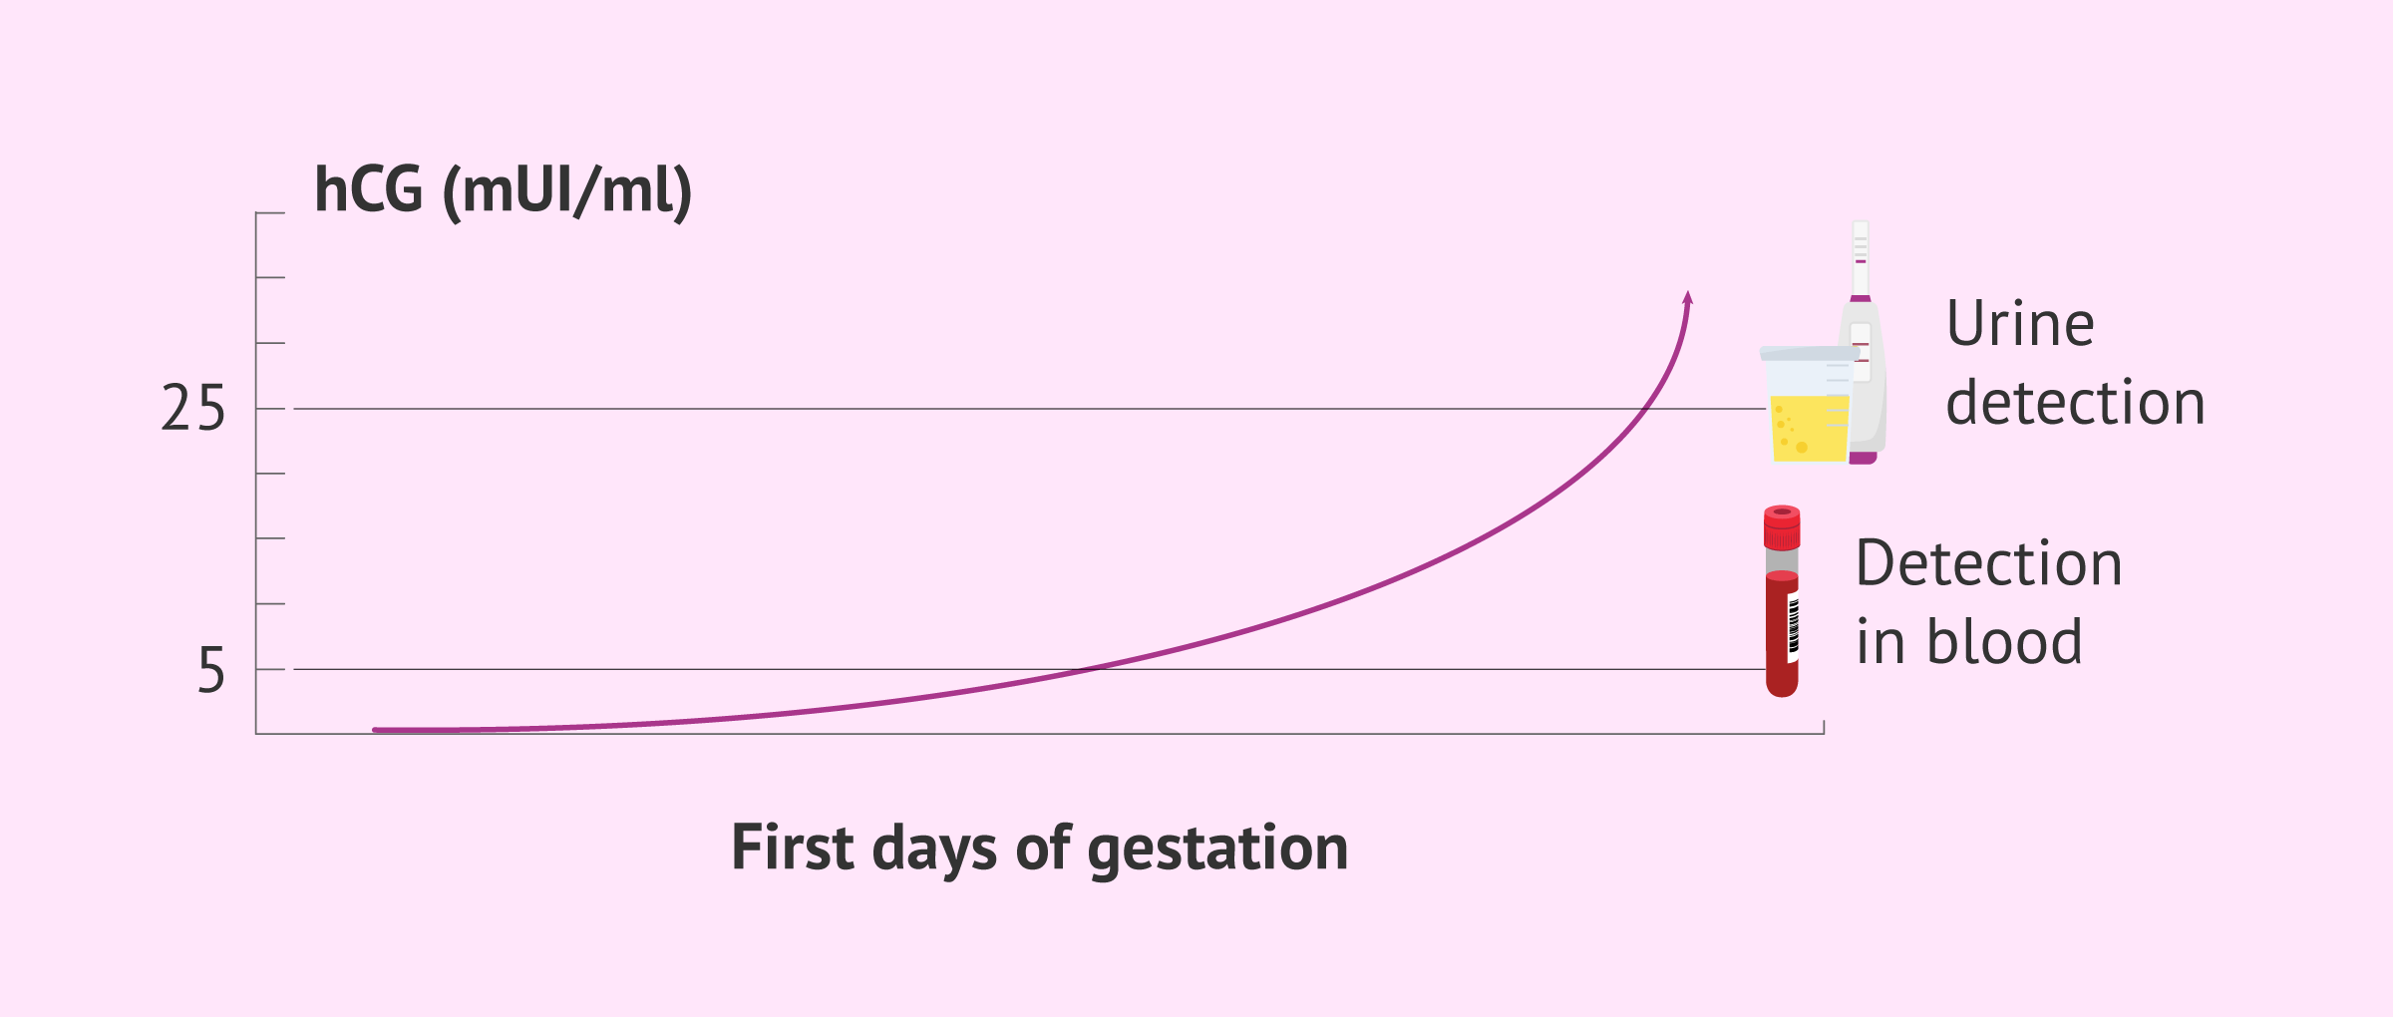
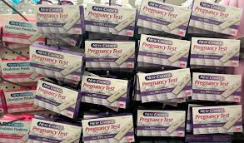
Risk of pregnancy
Pregnancy Test → only positive at 14dpo*
Sexual Activity
Unprotected Intercourse within past 5 days → Emergency Contraception
Contraception is not teratogenic!

Slide 7
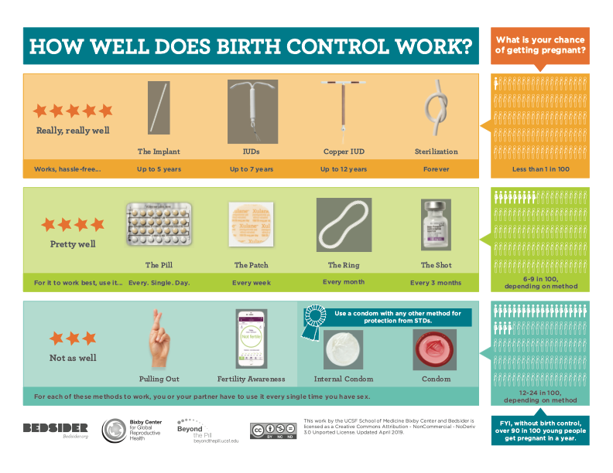
Progesterone ONLY
Estrogen
And
Progesterone

Slide 8
Estrogen contraindications
Estrogen increases thrombosis risk
Screen patient for other predisposing conditions
Most common at SCPA:
Complicated migraine
Sickle Cell Disease
Inherited clotting disorders: FVLeiden, MTFHR, etc
Cigarettes
Notes:
Sexual activity
How quickly do we need this?
Could we be pregnant
Estrogen- I consider this for ANY patient
Also

Slide 9
What is an Aura?
Temporary sensorial disturbance
20% of migraines
Usually visual

Slide 10
.HPIKSOCPNOCONTRAINDICATIONS
No personal history of complicated migraine, seizure, sickle cell, rhuematologic dz, liver disease, heart disease or deformity, stroke, diabetes, breast cancer or hypertension. She does not need to take antibiotics prior to dental work. She does not smoke cigarettes. She is not breastfeeding. No personal or first degree relative with dvt or pe.

Slide 11
LARCS
Long Acting Reversible Contraceptives
☺ Safe, effective
☺ Appropriate for adolescents
3-5+ years
Specialized insertion
Progestin only– irregular bleeding
Notes:
and are all appropriate for use in the adolescent population.
The safety, efficacy, and long-term cost-benefit factors of long-acting reversible contraception (LARC) use in the adolescent population have been well established.^{1–4} The noncontraceptive benefits, especially treatment of heavy uterine bleeding and dysmenorrhea, are also well accepted.^{5–7} Available LARC methods include 1 progestin subdermal implant and 5 intrauterine devices (IUDs) and are all appropriate for use in the adolescent population.⁴ The progestin subdermal implant works by suppressing ovulation, whereas the copper intrauterine device (Cu-IUD) and the progestin-releasing levonorgestrel intrauterine devices (LNG-IUDs) prevent fertilization.² LARC methods are the most effective forms of contraception, with less than 1% of users becoming pregnant during the first year of use

Slide 12
Combined Hormonal
Traditional
Easily start / stop
Withdrawal “period”
Missed doses --> pregnancy risk
Side effects
Clot risk: ACHES

Slide 13
Progesterone only
☺ No estrogen!
☺ No regular period!
☹ No regular period
? Increase in appetite?
Calcium related bone loss

Slide 14
Pick a method, counsel & start
Traditional Start:
Start on menses

Slide 15
Follow up 2-3 weeks
Exclude pregnancy
If estrogen medication: check BP, clot symptoms
Ensure proper use
Review counseling
Adolescent Family Planning

Slide 16
Other tools
Condoms always
Withdrawal, fertility awareness
Notes:
and are all appropriate for use in the adolescent population.
The safety, efficacy, and long-term cost-benefit factors of long-acting reversible contraception (LARC) use in the adolescent population have been well established.^{1–4} The noncontraceptive benefits, especially treatment of heavy uterine bleeding and dysmenorrhea, are also well accepted.^{5–7} Available LARC methods include 1 progestin subdermal implant and 5 intrauterine devices (IUDs) and are all appropriate for use in the adolescent population.⁴ The progestin subdermal implant works by suppressing ovulation, whereas the copper intrauterine device (Cu-IUD) and the progestin-releasing levonorgestrel intrauterine devices (LNG-IUDs) prevent fertilization.² LARC methods are the most effective forms of contraception, with less than 1% of users becoming pregnant during the first year of use

Slide 17
Emergency Contraception

Slide 18
General Landscape
Improved rates of contraception (not declines in sexual activity) have contributed to the decline in teen pregnancy risk over the past decade.
AND

Slide 19
What is Emergency Contraception?
A method of contraception used after unprotected sexual intercourse to reduce the risk of pregnancy
Unprotected (or under-protected) intercourse:
Sex with no contraception
Condom breakage or slippage
Missed or late doses of contraceptives
Vomiting after oral contraceptive pills
Sexual assault

Slide 20
Types
Levonorgestrel
Ulipristal (Ella)
Copper IUD insertion
Yuzpe method
Notes:
Ella prevents and delays ovulation like Plan B but can also make it harder for a fertilized egg to embed in the uterus. Works up to 5 days after unprotected sex and, unlike other EC pills, doesn’t decrease in effectiveness during those 5 days.

Slide 21
Levonorgestrel 1.5 mg PO x 1
Plan B One Step, Next Choice One Dose
Single pill with 1.5mg levonorgestrel (a progestin)
Take ASAP after unprotected intercourse
Package insert says 72 hours.... Real life may work up to 120 hours but less effective
With Medicaid: Free
With insurance: Free if you can get a prescription (otherwise see the “without insurance” section).
Without insurance: $35 - $49.99 in stores and pharmacies; $21.00 - $49.99 online.
Notes:
CDC recommendations indicate that young women in need of EC who do not wish to use a Cu-IUD or who do not have access to IUD insertion should be offered ECPs regardless of their weight.
Pediatricians should provide emergency contraception (EC) to teenagers who have had unprotected or underprotected intercourse, according to a policy statement from the American Academy of Pediatrics published online Nov. 18 in Pediatric

Slide 22
What is the yuzpe method?
Combined estrogen and progestin in 2 doses (Yuzpe regimen: 1 dose of 100 µg of ethinyl estradiol plus 0.50 mg of levonorgestrel followed by a second dose of 100 µg of ethinyl estradiol plus 0.50 mg of levonorgestrel 12 hours later)
How to do this:
Using a pack of combined oral contraceptive pills:
Look at the doses of estradiol and levonorgestrel in each pill
Take enough pills (usually 4) to equal 100 µg of ethinyl estradiol plus 0.50 mg of levonorgestrel once, and then 12 hours later take a second dose (4 more pills) of 100 µg of ethinyl estradiol plus 0.50 mg of levonorgestrel 12 hours later)

Slide 23
Mechanism of Action
If patient in pre-ovulatory phase, it blocks the LH surge and prevents ovulation.
If implantation has already occurred, it will not terminate the pregnancy, nor cause birth defects.

Slide 24
FAQs
What about co-existing conditions: sickle cell, epilepsy, migraines with aura
FDA says OK to use
What if very very early pregnant / PT still negative?
Won’t harm pregnancy. No known teratogenic effects
Does it matter what phase of cycle?
No
What if emesis after dose
If emesis within 1 hour, can re-take dose

Slide 25
Other info
Not effective as a repeat method of contraception
SO → Can start hormonal contraception immediately (same day)
NO EXAM, NO PREGNANCY TEST REQUIRED- provide rx in advance, or over phone
Recommend pregnancy test in 2-3 weeks

Slide 26
BIG FIVE 🖐
NO CONTRAINDICATIONS! (Except known pregnancy, only bc it won't work)
Take ASAP after unprotected sex, up to 5 days later
Mild nausea, heavier menses. Will NOT cause increased sexual activity! 😉
Educate patient about birth control🚺 (can start hormonal contraception)
Educate male patients about EC🚹

