Slide 1

N.O.R.T.H., INC.
Philadelphia WIC Program
Prepared by:
Administrative Nutrition Managers

Slide 2

What is ?
The Special Supplemental Nutrition Program for Women, Infants and Children (WIC) is a public health nutrition program under the USDA providing nutrition education, nutritious foods, breastfeeding support, and healthcare referrals for income-eligible women who are pregnant or post-partum, infants, and children up to age 5.

Slide 3
WIC Health Outcomes
Increase immunization rates
Increase access to prenatal care earlier in pregnancy
Increase pregnant women’s consumption of key nutrients such as iron, protein, calcium, and Vitamins A and C
Reduce premature births
Numerous studies show that WIC is effective and helps:
Increase access to regular health care
Reduce low and very low birth-weight babies
Reduce fetal and infant deaths
Improve diet quality
Reduce the incidence of low-iron anemia

Slide 4

N.O.R.T.H., Inc.
NORTH, Inc.- A non-profit agency that operates the Special Supplemental Nutrition Program for Women, Infants, and Children (WIC) in Philadelphia , PA
Located at: 1300 W. Lehigh Avenue
Suite 104
Philadelphia, PA 19132
(215) 978-6100

Slide 5
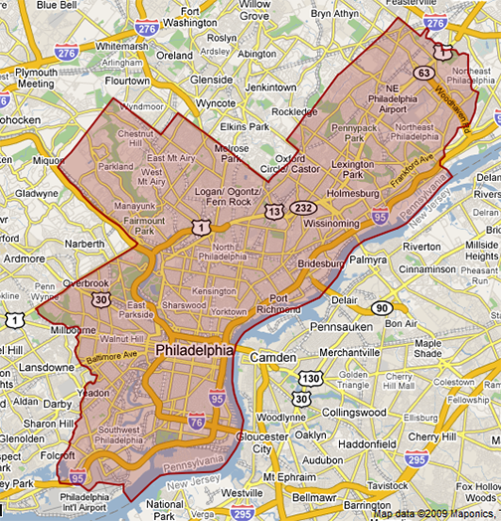
N.O.R.T.H., Inc.
Provides WIC benefits to over 50,000 women, infants, and children within the City/County of Philadelphia, PA.
WIC offices
Mobile WIC office delivers service to various satellite sites (shelters, high schools)
Largest single county non-profit in the Commonwealth

Slide 6
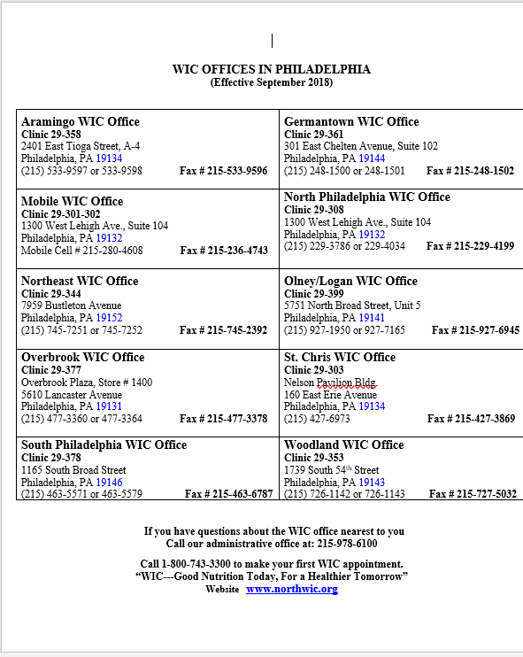
WIC Offices

Slide 7
Our Mission
The Pennsylvania WIC Program is committed to improving the health of eligible pregnant women, new mothers, and children by providing nutrition education, breastfeeding support, healthy foods, and referrals to health and social programs during the critical stages of fetal and early childhood development.

Slide 8

WIC Eligibility
Pregnant women
Breastfeeding women, for up to one year postpartum
Women up to six months postpartum, who are not breastfeeding
Infants and children under five years old, including foster children

Slide 9

WIC Eligibility
Must meet WIC income guidelines, which is at or below 185% of the poverty level set by the federal government and is based on household size.
  Unborn babies are counted in the household size.

Slide 10

WIC Eligibility
To receive WIC benefits in Pennsylvania, you must be a resident in this state.

Slide 11

WIC Eligibility
Must have a qualifying nutritional risk
WIC participants are assigned a nutritional risk, which is determined at the WIC certification appointment.
A nutritional risk is any behavior associated with diet, growth, or medical diagnosis that might impact your nutritional status.

Slide 12

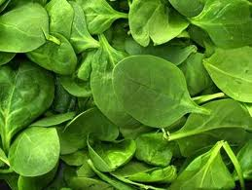


WIC Eligibility
Some examples of qualifying risks include anemia, underweight, overweight, premature baby, pregnancy complications.

Slide 13

WIC Nutrition Services
WIC monitors height, weight and blood iron to make sure infants and children grow and develop normally and pregnant women deliver healthy babies.

Slide 14

WIC Nutrition Services
Nutrition staff meets with each WIC participant individually to assess their diet, identify nutritional needs, provide individualized counseling to address those needs, and help the participant set a goal to improve their nutritional status.

Slide 15

Breastfeeding Promotion and Support
WIC encourages and supports breastfeeding. If a woman chooses not to breastfeed, then iron-fortified formula is provided as the best alternate source of essential nutrients for her infant.

Slide 16

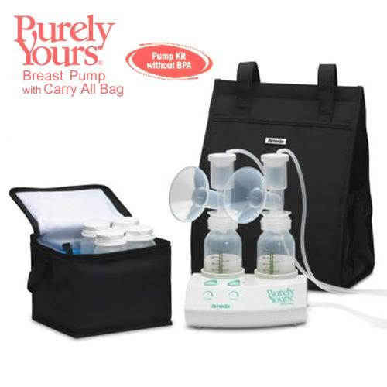
Breastfeeding Promotion and Support
  Fully breastfeeding mothers and infants receive the most WIC foods
  WIC staff receive special training in breastfeeding support
  If the participant is returning to work or school and not using any formula, she may be eligible to receive a free double-electric portable breast pump.

Slide 17

Breast pumps
Hospital grade- Medela and Ameda
For baby in the NICU and mom needs to transport milk to the hospital
$25 deposit to borrow
Deposit is returned when motor is returned
Return motor to WIC when baby is discharge

Slide 18
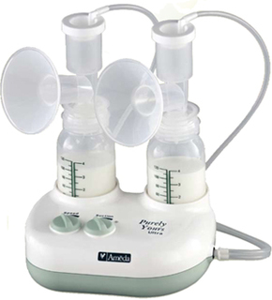
Breast pumps
Double-electric pump- Medela and Ameda
For single-use
Provided if returning to work or school and insurance does not cover
Free
Mom must commit to not to use formula for 3 months.
No Rx is necessary for WIC to provide a breast pump.
Mom keeps the breast pump

Slide 19

Referrals
WIC provides referrals to health, social service, or community agencies that could help your family.

Slide 20



Referrals
Referrals to:
  Immunization Programs
  Child Care Programs
  Dental Programs
  Breastfeeding Support Groups
  Family Planning
  Infant Giveaway Programs
  Behavior Change Programs (Smoking Cessation, etc.)

Slide 21
N.O.R.T.H., Inc.
Medical Providers can complete a “Risk Criteria Form” for WIC participants to bring to their WIC appointment

Slide 22

WIC Monthly Food Prescription
WIC provides a monthly prescription of nutritious foods tailored to supplement the dietary needs of participants to ensure good health, growth and development.

Slide 23

WIC Nutrition Services
The foods are specifically chosen to provide nutrients that have been scientifically shown to be lacking or needed in extra amounts in the diets of the WIC population.

Slide 24
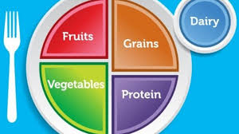

WIC Monthly Food Prescription
The foods are specifically chosen to provide consistency with the Dietary Guidelines for Americans and established dietary recommendations for infants and children under 2 years of age.
The selected foods also reinforce WIC nutrition education messages, address emerging public health nutrition-related issues, and provide wide appeal to the diverse WIC population.

Slide 25

The Pennsylvania WIC Food List
Supplemental Foods:
  WIC Vouchers are used for Foods listed in the PA WIC Food List
  Vouchers must be used at a WIC Approved Store
  Participants Must Show their WIC ID Card when Cashing their Vouchers
  Each participant is given a WIC approved Food List and training on how to use their WIC vouchers

Slide 26
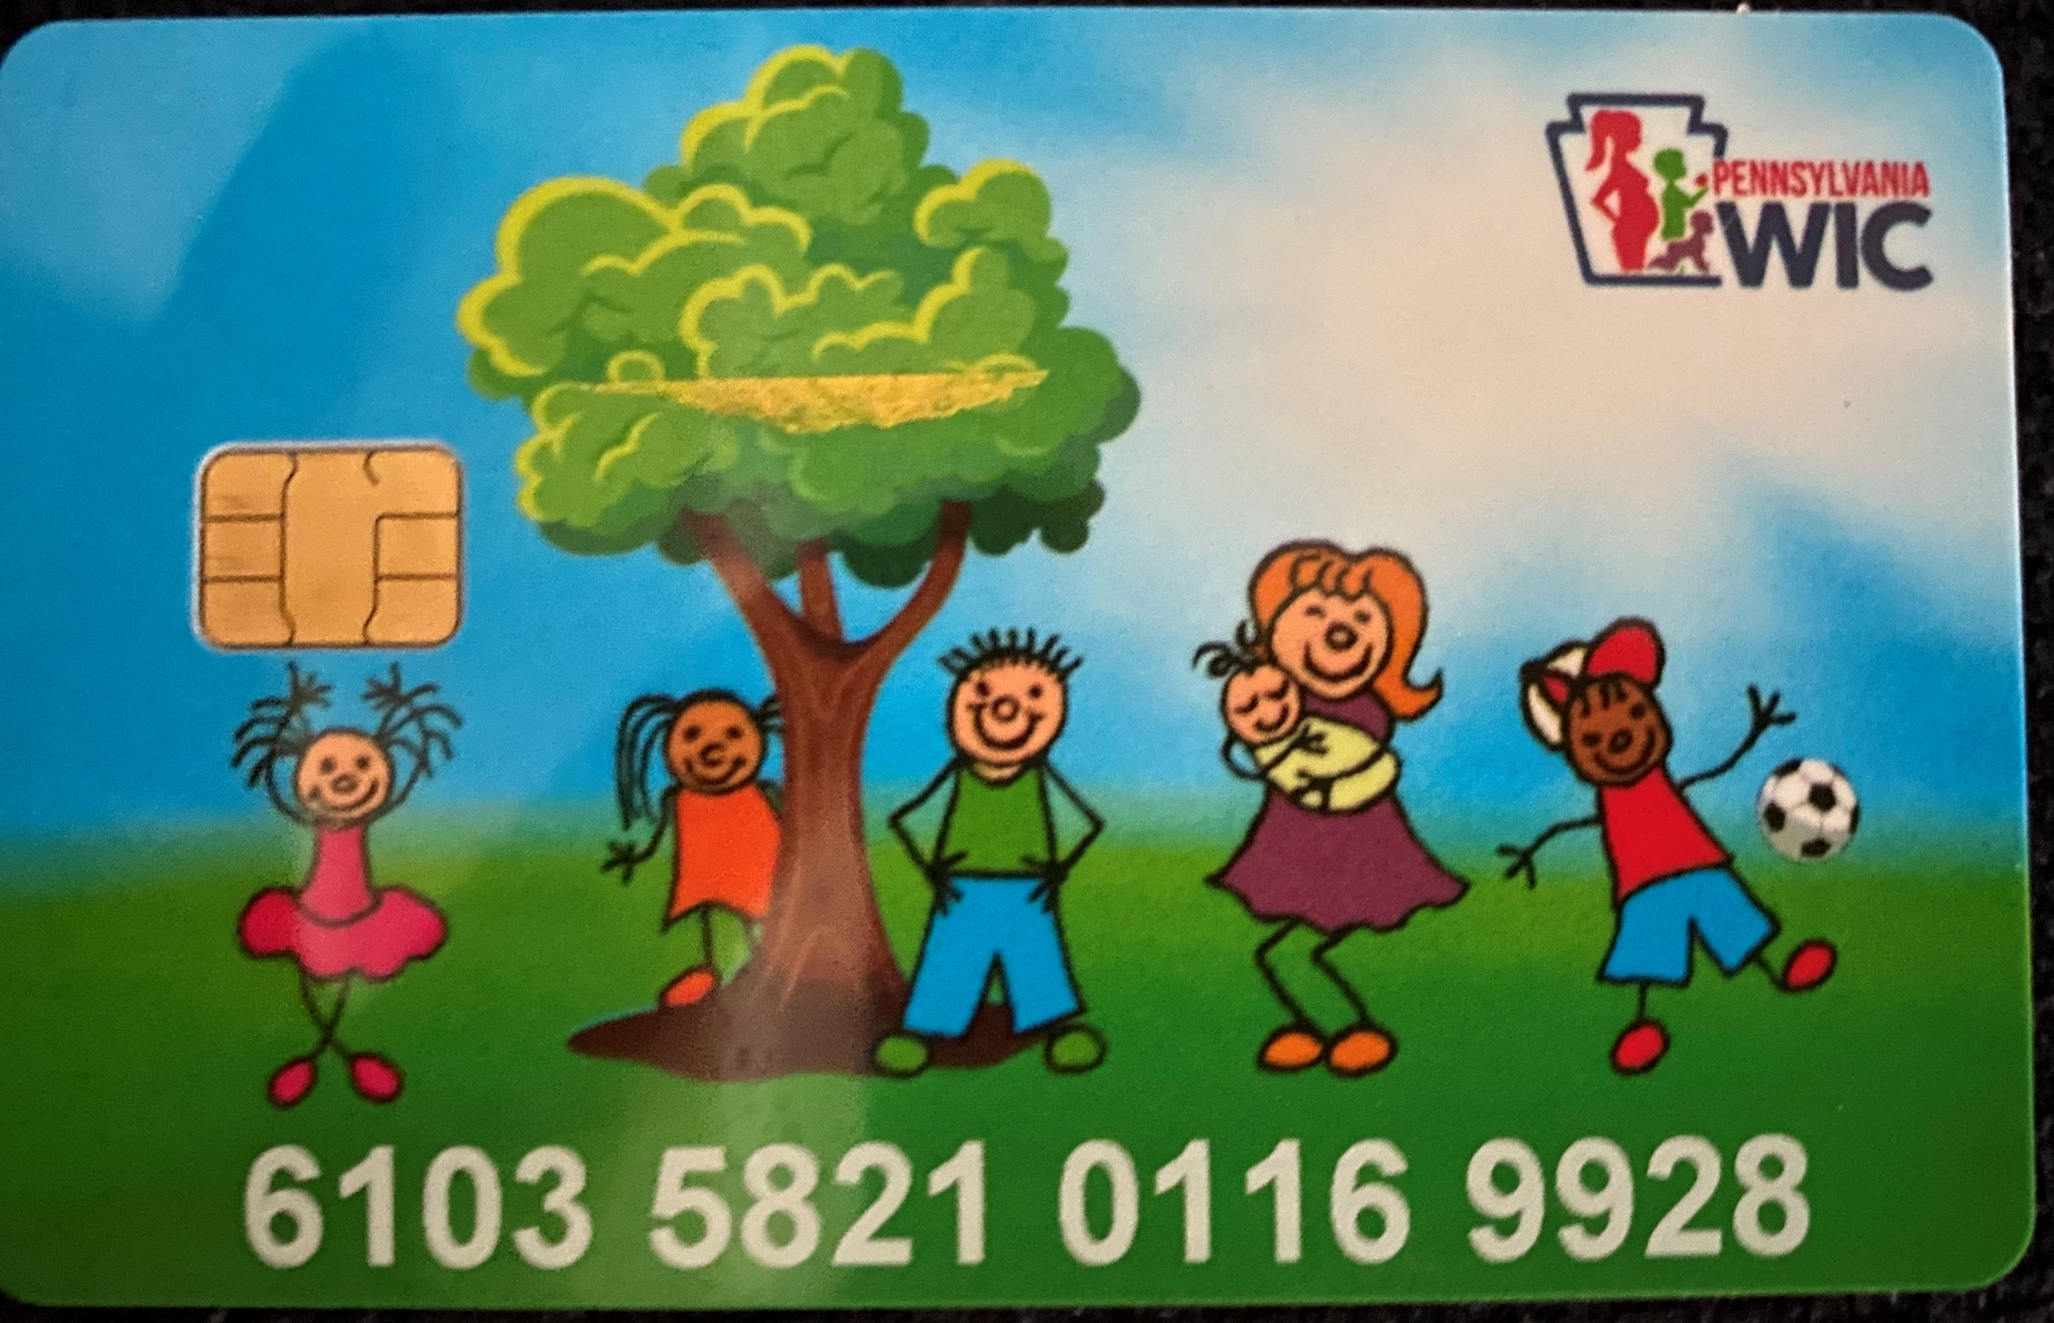
Example of WIC Check

Slide 27
Foods Available on WIC Vouchers
Infants
Formula (if not breastfed)
Infant cereal
Infant Fruits and Vegetables
Infant Meats (if breastfed)
Children from 12-23 months
Whole milk
Beans
Cereals
Eggs
Whole Grains
Juice
Fruits and Vegetables

Slide 28

Foods Available on WIC Vouchers
Children 2-5 years
  Low fat milk
  Beans or Peanut butter
  Cereal
  Eggs
  Whole Grains
  Juice
  Fruits and Vegetables

Slide 29
Foods Available on WIC Vouchers
Pregnant Women
  Low fat milk
  Beans
  Peanut butter
  Cereal
  Eggs
  Whole Grains
  Juice
  Fruits and Vegetables
Postpartum Women
  Low fat milk
  Beans or Peanut butter (Both if breastfeeding)
  Cereal
  Eggs
  Juice
  Fruits and Vegetables
  Whole grains (only if breastfeeding)
  Canned fish (only if breastfeeding)

Slide 30

The Pennsylvania WIC Food List
100% fruit juice- key nutrients are Vitamin C and Folate
American Academy of Pediatrics recommendation for children ages 1 - 6 is to limit juice to 4 - 6 ounces per day.
WIC provides 128 fl oz. of 100% fruit juice to children per month; roughly 4 fl. oz daily.

Slide 31
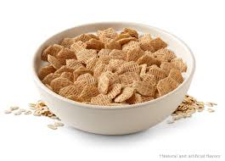
The Pennsylvania WIC Food List
  Cereals on the WIC Food List are low in sugar
  Key nutrients provided are Iron, B Vitamins, Folate, Fiber, and Zinc

Slide 32

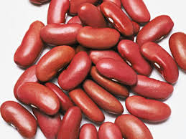
The Pennsylvania WIC Food List
Fruits and Vegetables-
  All potatoes added April 1, 2015
  canned, fresh, or frozen
Key nutrients are Vitamin A, C, E, Folate, Potassium, and Fiber
Beans and Peanut butter- Key nutrients are Protein, B Vitamins, Folate, Fiber

Slide 33

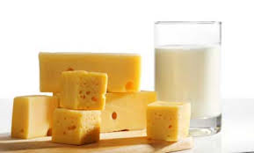
The Pennsylvania WIC Food List
Eggs- Key nutrients are Protein, Vitamins A & D
Milk and cheese- Key nutrients are Protein, Calcium, Vitamins A & D, Riboflavin, and Folate in milk

Slide 34
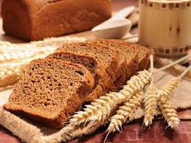
The Pennsylvania WIC Food List
  Whole grains such as Brown Rice, Whole Wheat Bread & Rolls, Whole Grain Tortilla, Whole Wheat Pasta, Oatmeal
  Key nutrients provided are Iron, B Vitamins, Magnesium, Zinc, Fiber

Slide 35


The Pennsylvania WIC Food List
Children 12-23 months- Whole milk is the standard
A Nutrition Professional can authorize reduced fat milks (2%) at their discretion with justification.

Slide 36

The Pennsylvania WIC Food List
Children 2 years of age or older and women receive 1% or skim milk on their WIC benefits.
2% milk may be substituted on a quart for quart basis at Nutrition Professional’s discretion and justification.

Slide 37


Milk Substitutes
Dairy substitution choices are: Cheese, Yogurt, Soy Beverage, and Tofu.
A Nutrition Professional can authorize these foods ; Medical documentation is only required if the participant receives Special Formula on the program.

Slide 38
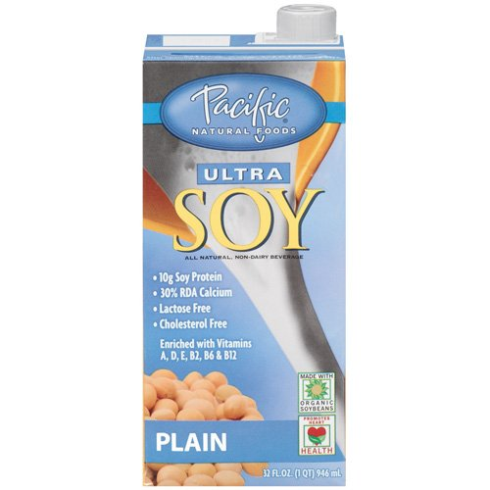
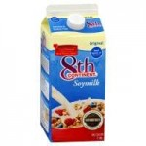
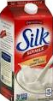
Milk Substitutes
Federal regulations require that Health Care Providers be aware of the reduced bioavailability of calcium in soy products, added sugars in soy beverages in comparison to low-fat cow’s milk for their patients.

Slide 39
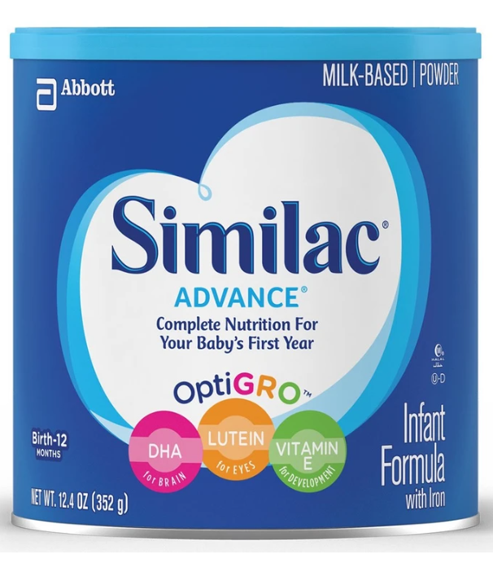
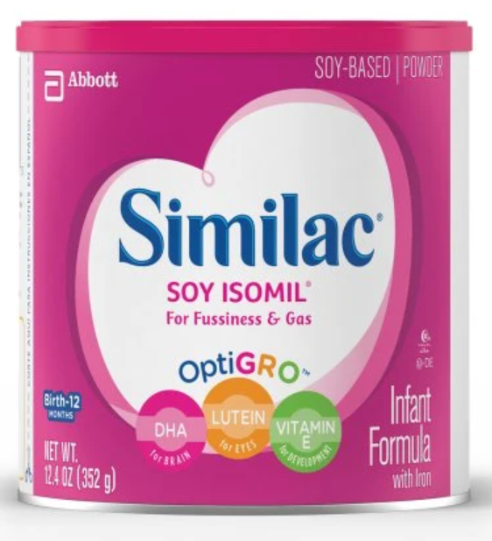
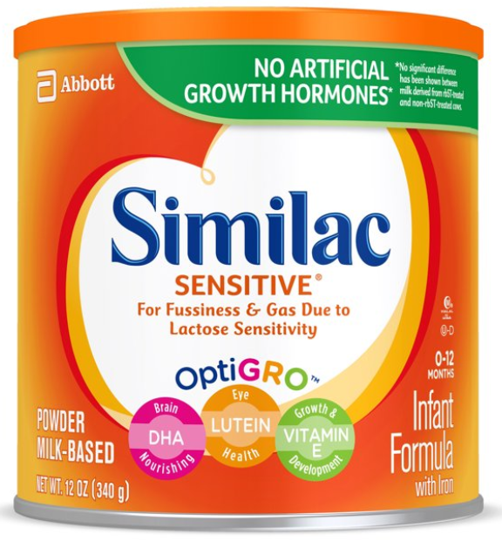
Contract Formula for WIC Infants
Similac Brand Formula
  Similac Milk-Based or Soy-Based Formula
  With proper medical authorization:
    Similac Sensitive
    Similac for Spit-up
    Similac Total Comfort

Slide 40
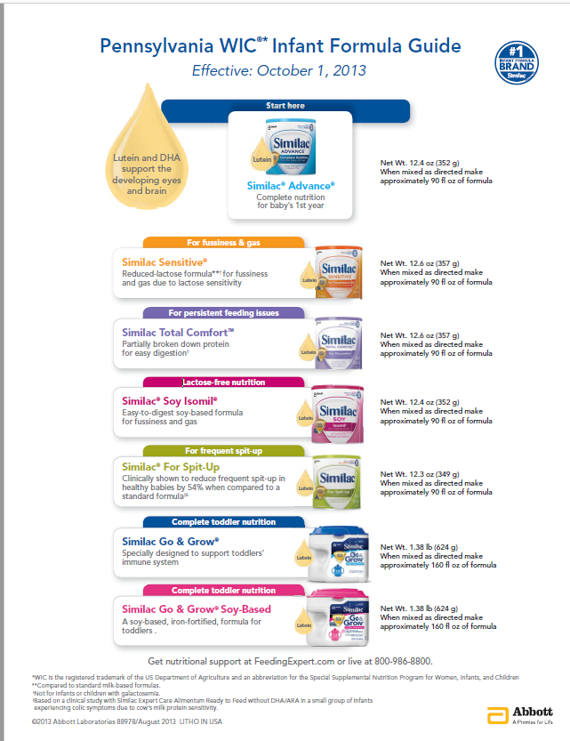

Slide 41
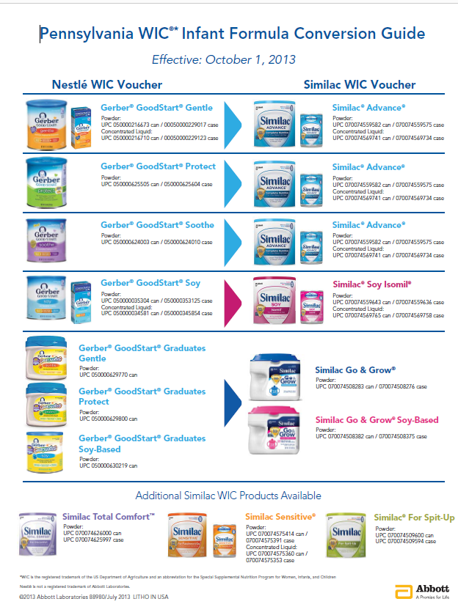

Slide 42

Special Formula
“Special formula” is any formula other than PA WIC’s contract formulas.
A completed “Formula Authorization Form” or prescription is required before a participant may receive Special Formula from the WIC Program.

Slide 43
Complete Prescription
A complete prescription should include:
  The name of the participant receiving formula(s)
  The name(s) and quantity(ies) of formula(s) being prescribed
  The reasons (medical condition) for the formula(s)
  Any special instructions related to the preparation, amount of formula(s) and/or feeding frequency of the formula(s)
  The signature of the physician, Certified Registered Nurse Practitioner, or Physician Assistant prescribing the formula(s)
  Current date
  Length of time the formula is needed
    Monthly renewal is required for premature formulas
  Any restricted foods as well as the length of restriction

Slide 44
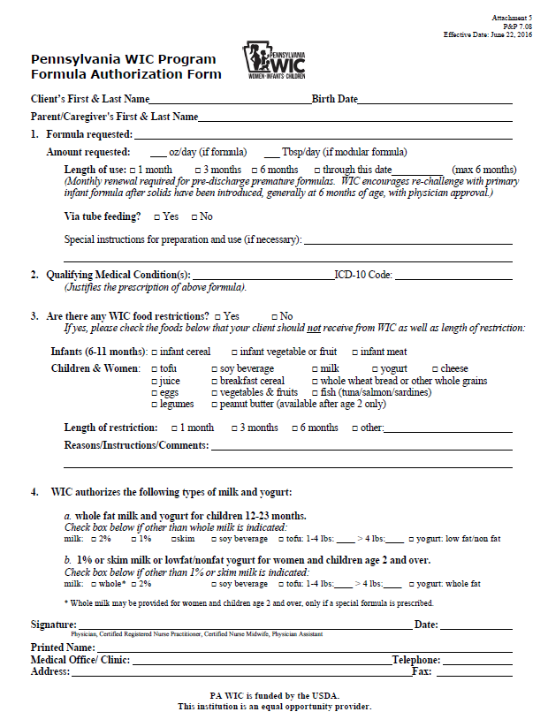

Slide 45

Restrictions to Special Formula
Any participant presenting a prescription requesting special formula solely for the purpose of enhancing nutrient intake or managing body weight without an underlying qualifying condition will not be able to receive exempt infant formula or WIC-eligible nutritionals from WIC

Slide 46

Special Formula
Prescriptions are not needed for contract brand, standard infant formulas, unless the participant is older than 1 year.
For children 2-5 years old and women receiving special formula, WIC can provide whole milk or 2% if indicated on the WIC formula authorization form.

